Slide 1
Data mapping from llm/ml evalutions to sql db
Prasad ADHAV
  R&T Scientist
  prasad.adhav@list.lu
  6th Nov 2025

Slide 2
contents
01
The Problem: Need to map results to one DB
02
BESSER SQL DB & DB Schema
03
The Solution with some examples
04
Next steps

Slide 3
The problem
  Different types of data
    different columns names
    different type: str, int, float
  Different types of tests to perform
  Different outputs from different tests
  Solution must be reproducible, flexible, minimal manual steps
  In the future it must fit into agentic workflow
The SQL DB is used by the Sandbox for data visualizations, report generation
Notes:
Large call outs are Arial Bold (Body) 16pt with line spacing set at Multiple 1.2
Paragraph headers are Arial Book (Body) 14pt with line spacing set at Multiple 1.0
Body Copy is Arial Book (Body) 11pt with line spacing set at Multiple 1.2
First level bullet body copy is Arial Book (Body) 11pt with line spacing set at Multiple 1.1
Second level bullet body copy is Arial Book (Body) 11pt with line spacing set at Multiple 1.1

Slide 4
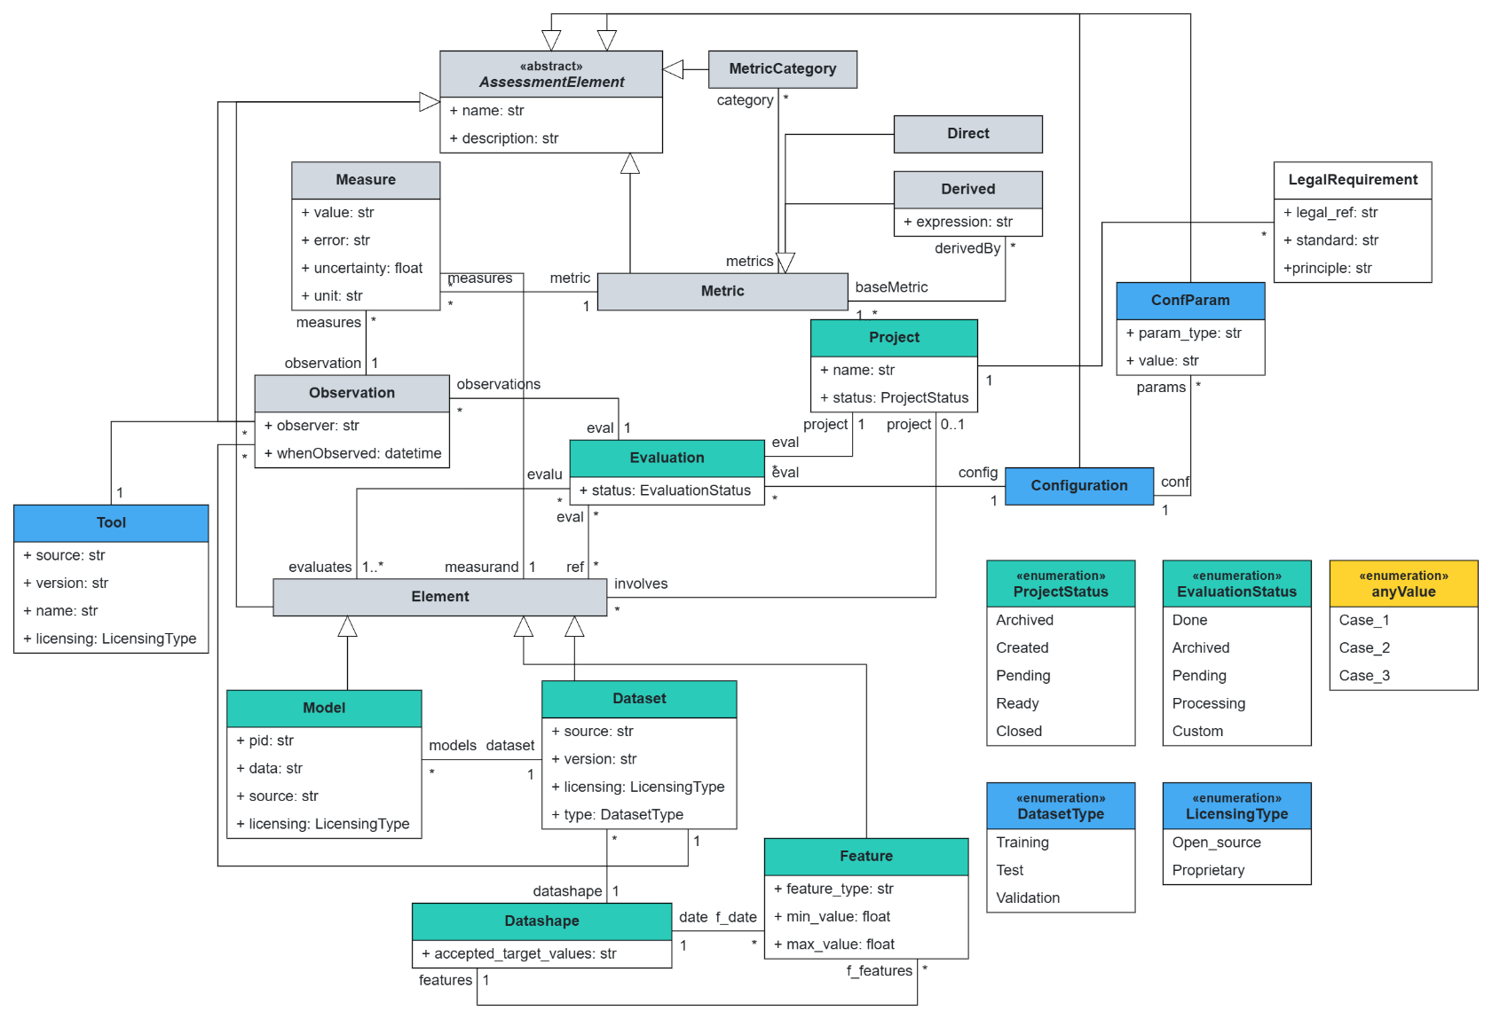
Besser sql
Db schema

Slide 5
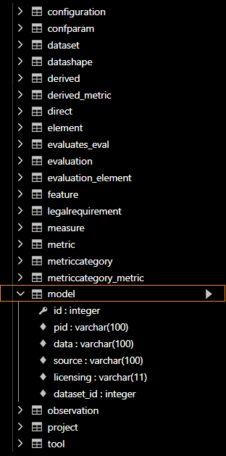
Sql db schema
  Each class in the diagram maps 1:1 to a table
    attributes → columns
    associations → foreign keys
  Each table has a YAML spec file
    Columns for that table
    Integer primary keys for identity
    foreign keys enforce referential integrity between tables

Slide 6
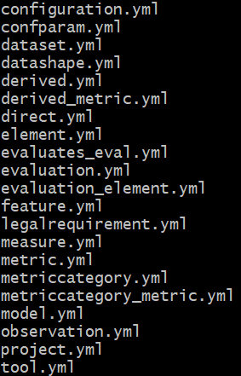
The solution: Data injection into Sql db
  Flexible ingestion: YAML specs map varied CSVs into the DB
    Just need to pass the “column name”
    Direct input is also possible
  One python script for populating all the data
    Reads the table structure & column names as described in YAML
    Populates into DB
python .\csv_to_sql_loader.py `
--db ".\ai_sandbox_db_name.db" `
--csv ".\LLM\results\results.csv" `
--spec ".\spec_templates_all_tables\model.yml”

Slide 7
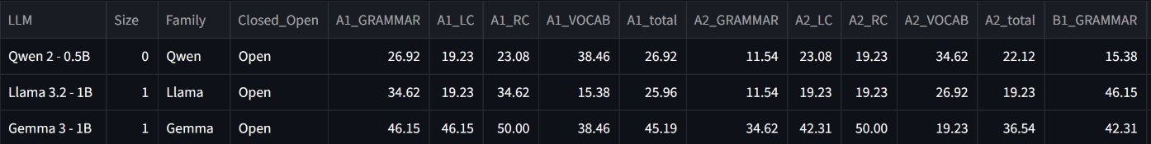
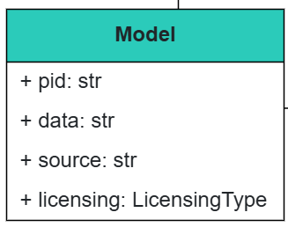
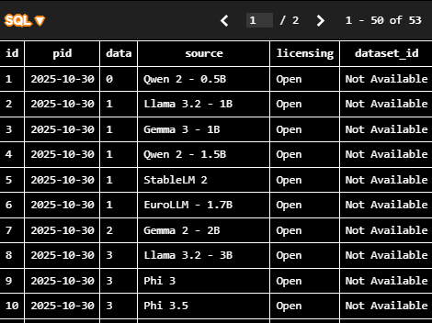
# Spec template for table: model
table: model
mode: upsert # or 'insert'
key: ['id']
columns:
# id: { from: "<CSV_id>", optional: true }
# pid: type=VARCHAR(100); REQUIRED
pid: { const: "2025-10-30" }
# data: type=VARCHAR(100); REQUIRED
data: { from: "Size" }
# source: type=VARCHAR(100); REQUIRED
source: { from: "LLM" }
# licensing: type=VARCHAR(11); REQUIRED
licensing: { from: "Closed_Open" }
# dataset_id: type=INTEGER; REQUIRED
dataset_id: { const: "Not Available" }

Slide 8
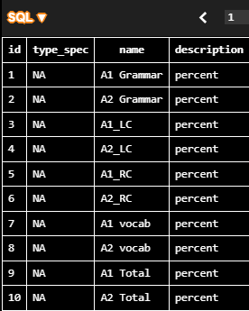
Example of loading columns not available in the results (User defined)
python .\csv_to_sql_loader.py `
--db ".\ai_sandbox_db_name.db" `
--csv ".\LLM\results\metric_catalog.csv" `
--spec ".\spec_templates_all_tables\metric.yml”
# metric_catalog.csv
name,measure
A1 Grammar,percent
A2 Grammar,percent
A1_LC,percent
A2_LC,percent
A1_RC,percent
A2_RC,percent
A1 vocab,percent
A2 vocab,percent
A1 Total,percent
A2 Total,percent
.
.
.
C1 vocab,percent
C2 vocab,percent
C1 Total,percent
C2 Total,percent
# Spec template for table: metric
table: metric
mode: upsert # or 'insert'
key: ['id']
columns:
# id: type=INTEGER; PK; AUTOINC-LIKE
# Tip: usually omit mapping for autoincrement PKs and let the DB assign them.
# id: { from: "<CSV_id>", optional: true }
# type_spec: type=VARCHAR(50); REQUIRED
type_spec: { const: "NA" }
# name: type=VARCHAR(100); REQUIRED
name: { from: "name" }
# description: type=VARCHAR(100); REQUIRED
description: { from: "measure" }

Slide 9
Next steps: sandbox integration
  Ask users for some preliminary information
    Simple csv/excel to tell mapping names
    Description of the data & columns
  The DB will be used on BESSER Dashboard
    Make plots in web modelling editor
    Generate reports
  Future steps: BESSER Agentic workflow to populate the DB

Slide 10
thank you
contact information
  prasad.adhav@list.lu

